Slide 1


Academic Writing
Section A
Presented by: Fatemeh Zununi
Spring 2020

Slide 2
Topics to be covered: 4 sections
A: The writing process (20th Khordad)
B: CARS model by Swale(20th Khordad)
C: Elements of writing (21th Khordad)
D. Accuracy in writing (21th Khordad)

Slide 3
A: The writing process
  Common types of academic writing
  The format of writing tasks
  The features of academic writing
  Assessing internet sources critically
  Critical thinking
  Avoiding plagiarism, Acknowledging sources
  summarizing and paraphrasing
  Brainstorming
  Outlines
  Finding key points and note-making
  The elements of effective paraphrasing and some techniques
  Stages of summarizing
  Citations and references
  abbreviations
  Proof-reading

Slide 4
B: CARS model by Swale
Paragraphs
Thesis statement
Topic sentence
CRS model by Swale
The moves in introduction
The moves in abstract
Final practice

Slide 5
C: Elements of writing
Argument and discussion
Cause and effect
Definitions
Generalisations
Cohesion, Preventing confusion
Components of academic style
Visual information

Slide 6
D. Accuracy in writing
Abbreviations and Acronyms
Academic vocabulary
Articles
Caution
Conjunctions
Nouns and adjectives
Prefixes and suffixes
Prepositions
Punctuation
Singular or plural?
Verbs – tenses

Slide 7
A 1. Types of academic writing
Notes : A written record of the main points of a text or lecture, for a student’s personal use.
Report: A description of something a student has done e.g. conducting a survey.
Project : A piece of research, either individual or group work, with the topic chosen by the student(s).
Essay: The most common type of written work, with the title given by the teacher, normally 1000–5000 words.
Dissertation/ Thesis : The longest piece of writing normally done by a student (20,000+ words) often for a higher degree, on a topic chosen by the student.
Paper : A general term for any academic essay, report, presentation or article.

Slide 8




The four main types of academic writing:
Descriptive
Analytical
Persuasive
Critical

Slide 9
In many academic texts you will need to use more than one type. For example, in an empirical thesis:
you will use critical writing in the literature review to show where there is a gap or opportunity in the existing research
the methods section will be mostly descriptive to summarise the methods used to collect and analyse information
the results section will be mostly descriptive and analytical as you report on the data you collected
the discussion section is more analytical, as you relate your findings back to your research questions, and also persuasive, as you propose your interpretations of the findings.

Slide 10
Descriptive
The simplest type of academic writing is descriptive.
Its purpose is to provide facts or information.
The kinds of instructions for a purely descriptive assignment include:
'identify‘
'report‘
'record‘
'summarize’
'define'.

Slide 11
Analytical
descriptive writing and re-organizing the facts and information you describe into
categories,
groups,
parts,
types
or relationships.
If you’re comparing two theories, you might break your comparison into several parts, for example: how each theory deals with social context, how each theory deals with language learning, and how each theory can be used in practice.

Slide 12
To make your writing more analytical:
spend plenty of time planning and try different ways of grouping them, according to patterns, parts, similarities and differences.
create a name for the relationships and categories you find. For example, advantages and disadvantages.
build each section and paragraph around one of the analytical categories.
make the structure of your paper clear to your reader, by using topic sentences and a clear introduction.

Slide 13
Persuasive
Persuasive writing has all the features of analytical writing (that is, information plus re-organizing the information), with the addition of your own point of view.
Most essays are persuasive, and there is a persuasive element in at least the discussion and conclusion of a research article.
Points of view in academic writing can include an argument, recommendation, interpretation of findings or evaluation of the work of others.
In persuasive writing, each claim you make needs to be supported by some evidence, for example a reference to research findings or published sources.

Slide 14
To help reach your own point of view on the facts or ideas:
read some other researchers' points of view on the topic. Who do you feel is the most convincing?
look for patterns in the data or references. Where is the evidence strongest?
list several different interpretations. What are the real-life implications of each one? Which ones are likely to be most useful or beneficial? Which ones have some problems?
discuss the facts and ideas with someone else. Do you agree with their point of view?

Slide 15
To develop your argument
list the different reasons for your point of view
think about the different types and sources of evidence which you can use to support your point of view
consider different ways that your point of view is similar to, and different from, the points of view of other researchers
look for various ways to break your point of view into parts.

Slide 16
To present your argument, make sure:
your text develops a coherent argument where all the individual claims work together to support your overall point of view
your reasoning for each claim is clear to the reader
your assumptions are valid
you have evidence for every claim you make
you use evidence that is convincing and directly relevant.

Slide 17
Critical
While persuasive writing requires you to have your own point of view on an issue or topic, critical writing requires you to consider at least two points of view, including your own.
You may explain a researcher's interpretation or argument and then evaluate the merits of the argument, or give your own alternative interpretation.
Examples of critical writing assignments include a critique of a journal article, or a literature review that identifies the strengths and weaknesses of existing research. The kinds of instructions for critical writing include: 'critique', 'debate', 'disagree' and 'evaluate'.

Slide 18
You need to
accurately summarize all or part of the work.
have an opinion about the work.
provide evidence for your point of view.
Critical writing requires strong writing skills. You need to thoroughly understand the topic and the issues.

Slide 19
2. the format of long and short writing tasks
Introduction
Main body
Conclusion
Introduction , , the CARS model
Main body Literature review Case study Discussion
Conclusion
References
Appendices

Slide 20
  3. The features of academic writing
Title
sub-title
heading
phrase
Sentence
paragraph

Slide 21

4. Assessing internet sources critically
unreliable or out-of-date sources are risky
• Is this a reputable website, for example with ac. (= academic) in the URL?
Is the name of the author given, and is he/she well-known in the field?
Is the language of the text in a suitable academic style?
Are there any obvious errors in the text, e.g. spelling mistakes, which suggest a careless approach?

Slide 22

5. Critical thinking
actively questioning and assessing
Ask yourself:
(a) What are the key ideas in this?
(b) Does the argument of the writer develop logically, step by step?
(c) Are the examples given helpful? Would other examples be better?
(d) Does the author have any bias?
(e) Does the evidence presented seem reliable, in my experience and using common sense?
(f) Is this argument similar to anything else I have read?
(g) Do I agree with the writer’s views?

Slide 23
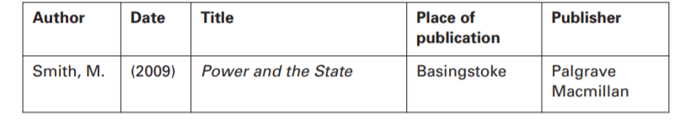
6. Avoiding plagiarism, Acknowledging sources
plagiarism means taking ideas or words from a source without giving credit (acknowledgement) to the author.
It is seen as a kind of theft, and is considered to be an academic crime. In academic work, ideas and words are seen as private property belonging to the person who first thought or wrote them.

Slide 24
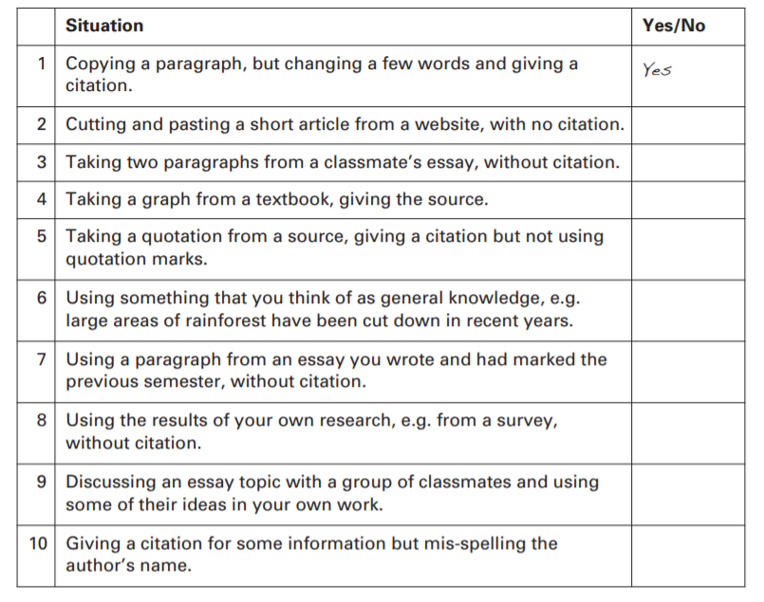
Some practice

Slide 25
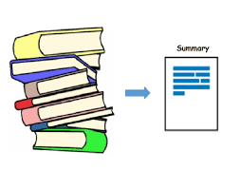
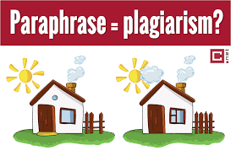
7. summarizing and paraphrasing
Paraphrasing involves re-writing a text so that the language is substantially different while the content stays the same.
Summarizing means reducing the length of a text but retaining the main points.

Slide 26

8. Brainstorming
write down any ideas you have, in any order and include the advantages and disadvantages.
brainstorm ideas for the title below:
What are the pros and cons of taking English language courses?.

Slide 27
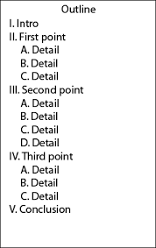
9. Outlines
An outline should help the writer to answer
the question as effectively as possible.
Note that for coursework it is usually better to
write the main body first, then the introduction and finally the conclusion. Therefore you may prefer to outline just the main body at this stage.
There is no fixed pattern for an outline; different methods appeal to different students.

Slide 28
10. Finding key points and note-making
(a) You must use your own words and not copy phrases from the original to avoid the risk of plagiarism.
(b) Always record the source of your notes, to save time when you have to write the list of references.
(c) Notes are written quickly, so keep them simple. Do not write sentences. Leave out articles (a/ the) and prepositions (of/ to).
(d) If you write lists, it is important to have clear headings (underlined) and numbering systems (a, b, c, or 1, 2, 3,) to organise the information. Do not crowd your notes.
(e) Use symbols (+, >, = ) to save time.
(f) Use abbreviations (e.g. = for example).

Slide 29
11. The elements of effective paraphrasing and some techniques
while summarizing aims to reduce information to a suitable length, paraphrasing attempts to restate the relevant information.
Note that an effective paraphrase usually:
• has a different structure to the original
• has mainly different vocabulary
• retains the same meaning
keeps some phrases from the original that are in common use e.g. ‘industrial revolution’ or ‘eighteenth century’

Slide 30
Techniques for paraphrasing
(a) Changing vocabulary by using synonyms: argues > claims/ eighteenth century > 1700s
Do not attempt to paraphrase every word, since some have no true synonym, e.g. demand, economy, energy
(b) Changing word class: explanation (n.) > explain (v.) / mechanical (adj.) > mechanise (v.) / profitable (adj.) > profitability (n.)
(c) Changing word order

Slide 31
Stages of summarizing
(a) Write the summary from your notes, re-organizing the structure if needed.
(b) Make notes of the key points, paraphrasing where possible.
(c) Read the original text carefully and check any new or difficult vocabulary.
(d) Mark the key points by underlining or highlighting.
(e) Check the summary to ensure it is accurate and nothing important has been changed or lost.

Slide 32
13. References and quotations
There are three principal reasons for providing references and citations:
(a) To show that you have read some of the authorities on the subject, which will give added weight to your writing.
(b) To allow the reader to find the source, if he/ she wishes to examine the topic in more detail.
(c) To avoid plagiarism
A quotation: Author’s name, date of publication, page no. (Smith, 2009: 37)
A summary: Author’s name, date of publication Smith (2009)

Slide 33
14. Abbreviations
In-text citations use the following abbreviations, derived from Latin and printed in italics:
et al.: normally used when there are three or more authors. The full list of names is given in the reference list: Many Americans fail to vote (Hobolt et al., 2006: 137).
ibid.: taken from the same source (i.e. the same page) as the previous citation: Older Americans are more likely to vote than the young (ibid.)

Slide 34
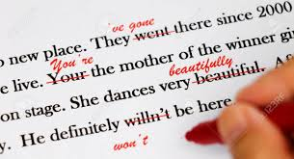
15. Proof-reading
Proof-reading means checking your work for small errors that may make it more difficult for the reader to understand exactly what you want to say.
Ask an editor

Slide 35

Time for a break?

